Slide 1
UNBEATABLE BRAIN
How To Enhance Your Brain & Hack Cognitive Performance
Ben Greenfield
BenGreenfieldFitness.com

Slide 2
1
2
3
HOW TO
FIX YOUR NEUROTRANSMITTERS
HOW TO
FIX HPA AXIS DYSFUNCTION
HOW TO
INCREASE YOUR BRAIN POWER

Slide 3
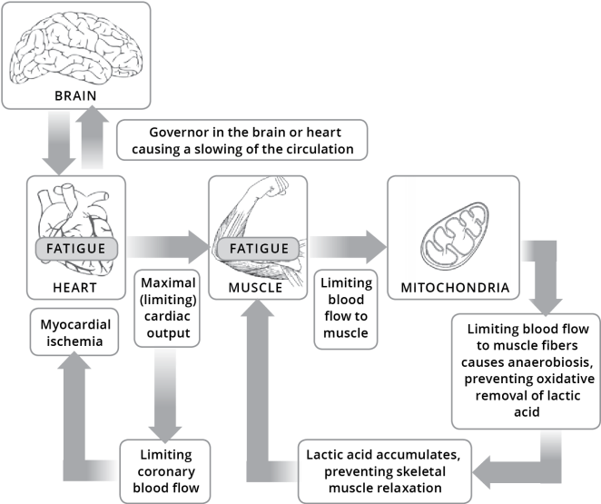
THE CENTRAL GOVERNOR MODEL OF FATIGUE
Fatigue starts in your brain, not your muscles
Brain shuts body down, not vice versa
Dr. Timothy Noakes
Fatigue goes beyond oxygen
THE VICIOUS CYCLE OF BRAIN FATIGUE
Notes:
The Central Governor Model of Fatigue
When it comes to achieving peak physical performance or pushing yourself to the extreme limits of endurance exhaustion, what do you think is the most important part of your physiology?
Your muscles?
Your heart?
Your lungs?
The surprising answer is “none of the above”.
The ultimate arbiter of fatigue is actually situated right between your ears. That’s right: it’s your brain.
The concept of the brain being the central cause of fatigue is a theory I first encountered when I interviewed Dr. Timothy Noakes in the podcast episode, “How You Can Use The “Central Governor” To Tap Into Your Muscle’s Hidden Potential.” In this episode, Dr. Noakes explains how being tired can all be in your mind, and that you can actually trick your body into exercising for a longer period of time, going harder, or lifting heavier, if you “distract” it with techniques like counting to 20, 50 or 100 over and over again, focusing on a small intermediate goal like the next telephone pole, street sign or repetition, listening to driving music, engaging in repetitive self-talk, or even using mental visualization exercises before your big workout or event.
What Dr. Noakes calls the “Central Governor” model of fatigue is based on the fact that if your brain or your heart run out of oxygen or experience sustained periods of hypoxia (low oxygen), then you can die or undergo permanent damage to these organs. So your brain (the central governor) is wired to limit how hard, how heavy or how long you can go by reducing your nervous system’s recruitment of muscle fibers. And this reduced recruitment causes the sensation of fatigue. Your brain simply says “stop” and your body obeys.
It’s possible that the fatigue goes beyond simply oxygen, and may also be based on the amount of ketones (fatty acids) or trace amounts of glucose available to your vital organs – so you can think of the central governor model as a kind of survival mechanism in which your brain makes a conscious effort to limit energy expenditure in order to save fuel for other precious organs such as your heart, your lungs and your brain.
The diagram below shows the vicious cycle that can ensue when your brain begins to shut down circulation to your heart and your muscles.

Slide 4
DECISION-MAKING FATIGUE
Fatigue
can be compounded if distracted
More a state of mind than physiological state
Conflict resolution
Example: runners shifting gears
Notes:
Decision-Making Fatigue
Interestingly, the fatigue brought on by your central governor can be compounded if you are distracted by other details, such as problem solving, complexity of an exercise or movement, or stressful thoughts about work, family or life.
Dr. Samuele Marcore, a UK sports scientist, believes that because of this, fatigue can be a perception of your mind just as much as a physiological state. He bases this on the fact that the anterior cingulate cortex in your brain is the area responsible for control of your heart rate and breathing, but also the area responsible for making complex decisions, paying attention to detail, and doing things like figuring out if you are supposed to be using your right leg or left leg, interpreting a financial spreadsheet, or not getting distracted by commotion going on around you. In other words, the more you’re requiring your brain to do at any given time, the faster it’s probably going to fatigue – regardless of how fit your muscles, lungs or heart are.
Dr. Marcore argues that this kind of physical fatigue is simply a matter conflict resolution – a struggle between the part of your brain that wants you to quit and the part that wants you to keep going – and that the more “decision-making” fatigue you’re subjected to during exercise, the faster you’re going to physically fail.
This belief that fatigue is more a state of mind than an actual physiological state makes perfect sense when you watch runners who seem to be on the brink of complete physical break-down suddenly shift gears into into an all-out sprint for the last 200-to-300 yards of a 5K race – when they looked like they could not run another step just a few moments before.

Slide 5
SHOCKING THE BRAIN INTO SUBMISSION
PAIN
PLEASURE
Study on cyclists using transcranial direct-current stimulation (tDCS)
The results
of this brain
tweaking?
Increased performance
may go beyond
mere distraction
Notes:
Shocking The Brain Into Submission
A brand new study on cyclists adds even more credence to the idea that your brain is ultimately responsible for fatigue. In this study, Brazilian sports scientists used a non-invasive form of brain stimulation called transcranial direct-current stimulation (tDCS) to apply a tiny electrical current to the cortex in the brain (6). Remember, this cortex is the primary culprit when it comes to exercise fatigue (5). The idea was that this stimulation would briefly interrupt the way neurons in the cortex communicate with each other, and distract the brain from shutting down the body. Of course, there was also a control group of cyclists that also had the electrodes attached, but didn’t get any stimulation.
So what were the results of this brain tweaking? After 20 minutes of real or fake brain stimulation, the cyclists completed an all-out ride to exhaustion. And sure enough – the cyclists who underwent the electrical stimulation had significantly lower heart rates, lower perceived exertion and a 4% higher power output (that may sound small, but is actually huge for a cyclist).
The researchers noted that this increased performance may go above and beyond mere “distraction” of the brain, but may actually be caused by a mingling of pleasure and pain centers in the brain. This is because the right side of the cortex is strongly linked to feelings of pain and physical exertion, while the left side of the cortex is linked to pleasant feelings and emotions that occur when you one see someone smile, or hear your favorite song, or cuddle up with loved one.

Slide 6
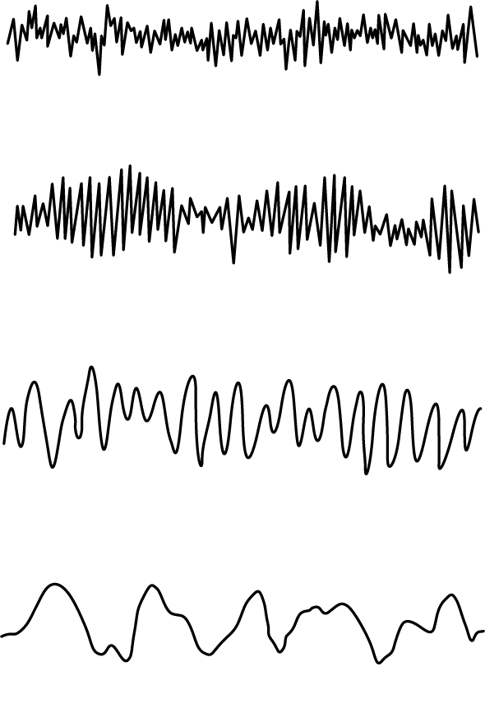
WHAT IS THE ZONE?
BRAIN WAVE PATTERNS
Energized focus and calm
If your brain is healthy enough and trained enough
You must fix your brain to allow your body to perform
BETA 'Aware State'
ALPHA 'The Zone'
THETA 'Deeper Trance'
DELTA 'Sleep State'
Notes:
What Is The Zone?
Interestingly, this feeling of pleasure or happiness in the presence of physical exertion is very similar to what is often described being “in The Zone”.
In psychology, being in The Zone”is a mental state of operation in which a person performing an activity is fully immersed in a feeling of energized focus, full involvement, and enjoyment in the entire process (7). When an athlete reaches the zone during physical performance, they often achieve their personal bests, while describing their performance as “effortless”. And the zone is not just an “airy-fairy” state – in sports performance laboratories, the 8-12 Hz alpha brain waves that you learned about in Chapter 10 have been shown to be correlated with these zone-like states of relaxed alertness.
Ultimately, the final take-away message from Dr. Noakes, Dr. Marcora, and those crazy Brazilian cyclist-electrocuting scientists is this: if your brain is healthy enough to optimally process information and communicate with your body, and trained enough to resist getting distracted, then you are not only going to perform better, but you are also going to equip your brain to achieve that level of effortless performance called The Zone.
So let’s say you want to override your central governor, distract your brain, and enter the coveted Zone so that you can push your body and mind beyond what you’ve ever imagined you’re capable of achieving? And let’s say you want to do it without wearing a giant cap full of electrodes and undergoing mild shock therapy treatment?
The fact is that in the same way that you must fix your gut prior to giving it the thousands of calories necessary for fueling huge amounts of physical activity, you must also fix your brain prior to asking it to allow your body to perform amazing feats of physical performance. So let’s dig into the two ways your brain breaks, and exactly what you can do about it.

Slide 7
THE TWO WAYS YOUR BRAIN BREAKS
NEUROTRANSMITTER
PROBLEMS
POORLY FUNCTIONING AND POORLY TRAINED BRAINS DUE TO…
HPA
AXIS DYSFUNCTION
1
2
If these are addressed you can experience mental and physical performance breakthroughs
Notes:
The Two Ways Your Brain Breaks
As you now know, it’s very obvious that your brain is the primary determinant of where your true performance capabilities lie – not to mention that a well-functioning, optimally tuned brain is also pretty darn important when it comes to your quality of life, your work productivity, your communication skills, your problem solving abilities and much more.
But unfortunately, most of us walk around with broken, inflamed, poorly functioning and poorly trained brains. This is usually due a combination of two factors:
1. Neurotransmitter Problems
2. HPA Axis Dysfunction
If both these issues are addressed, then your brain tissue, nerve cells and neurons will be healthy enough to optimally process information and seamlessly communicate with your body during a workout or a race, healthy enough for you to train your brain to resist getting distracted by morning work or tempting foods, and healthy enough for your mind to allow you to experience huge mental and physical performance breakthroughs.
So let’s learn how to fix both these issues, shall we?

Slide 8
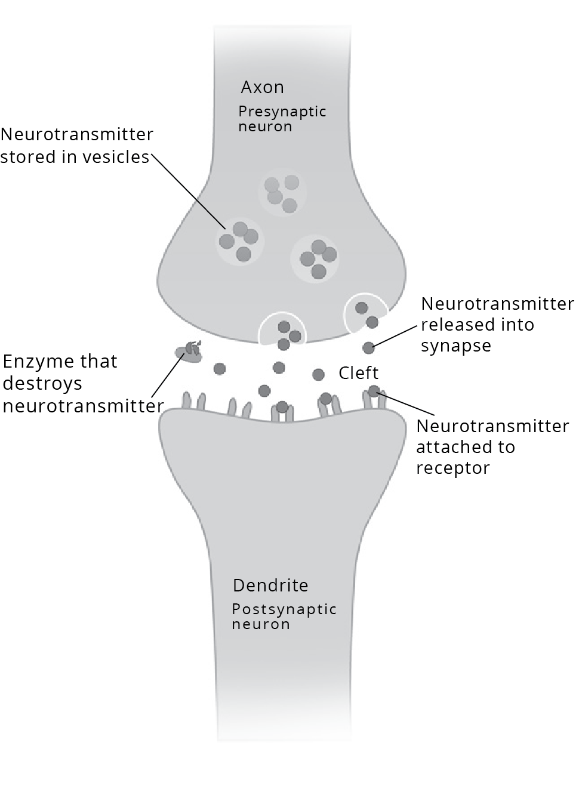
HOW NERVES
COMMUNICATE
Cells make connections in neural pathways
Synaptic transmission and serotonin
Monoamine oxidase (MAO) and
catechol-o-methyl transferase (COMT) enzymes
Notes:
How Nerves Communicate
Before understanding neurotransmitter problems, you need to understand how your nerves actually communicate with one another. Obviously this chapter is not meant to be a comprehensive primer on the nervous system, but it’s important that you know why neurotransmitters are so dang important.
Like the wires in your home electrical system, nerve cells make connections with one another in tiny circuits called neural pathways. But unlike the wires in your home, these nerve cells do not touch, but instead come very close together at a synapse (pictured below). At the synapse, the two nerve cells are separated by a small gap, which is called a synaptic cleft. The sending neuron is called the presynaptic cell (in this case, an axon), while the receiving neuron is called the postsynaptic cell (in this case, a dendrite).
In a one-way direction across the synapse from the presynaptic cell to postsynaptic cell, your body sends chemical messages using neurotransmitters, which you first learned about in Chapter 4, when discovering how to enhance your power and speed. This is called synaptic transmission.
Let’s look at an example of synaptic transmission that uses a neurotransmitter which you may have heard of before: serotonin.
In this case, the pre-synaptic cell would make serotonin from an amino acid called tryptophan and then packages the serotonin into vesicles located in end terminals. When a signal called an action potential arrives from your brain, that signal passes down presynaptic cell into the end terminals (3).
At this point, when the signal arrives, the serotonin is released and passes across the synaptic cleft, where it binds with special proteins called receptors on the outside of the postsynaptic cell. If enough serotonin binds to receptors, a threshold level is reached, and the action potential will be propagated in that cell and move on to the next cell. In the case of something like your muscles moving, the action potential would eventually reach skeletal muscle fibers and cause a contraction.
So that the nerve doesn’t remain in a constantly “turned on” state, the remaining serotonin molecules in the synaptic cleft then get destroyed by special enzymes in the cleft called monoamine oxidase (MAO) and catechol-o-methyl transferase (COMT). Some serotonin also gets taken back up by specific transporters on the presynaptic cell (this is called “reuptake”). All of this enables the nerve signal to be turned “off” and readies the synapse to receive another action potential.

Slide 9
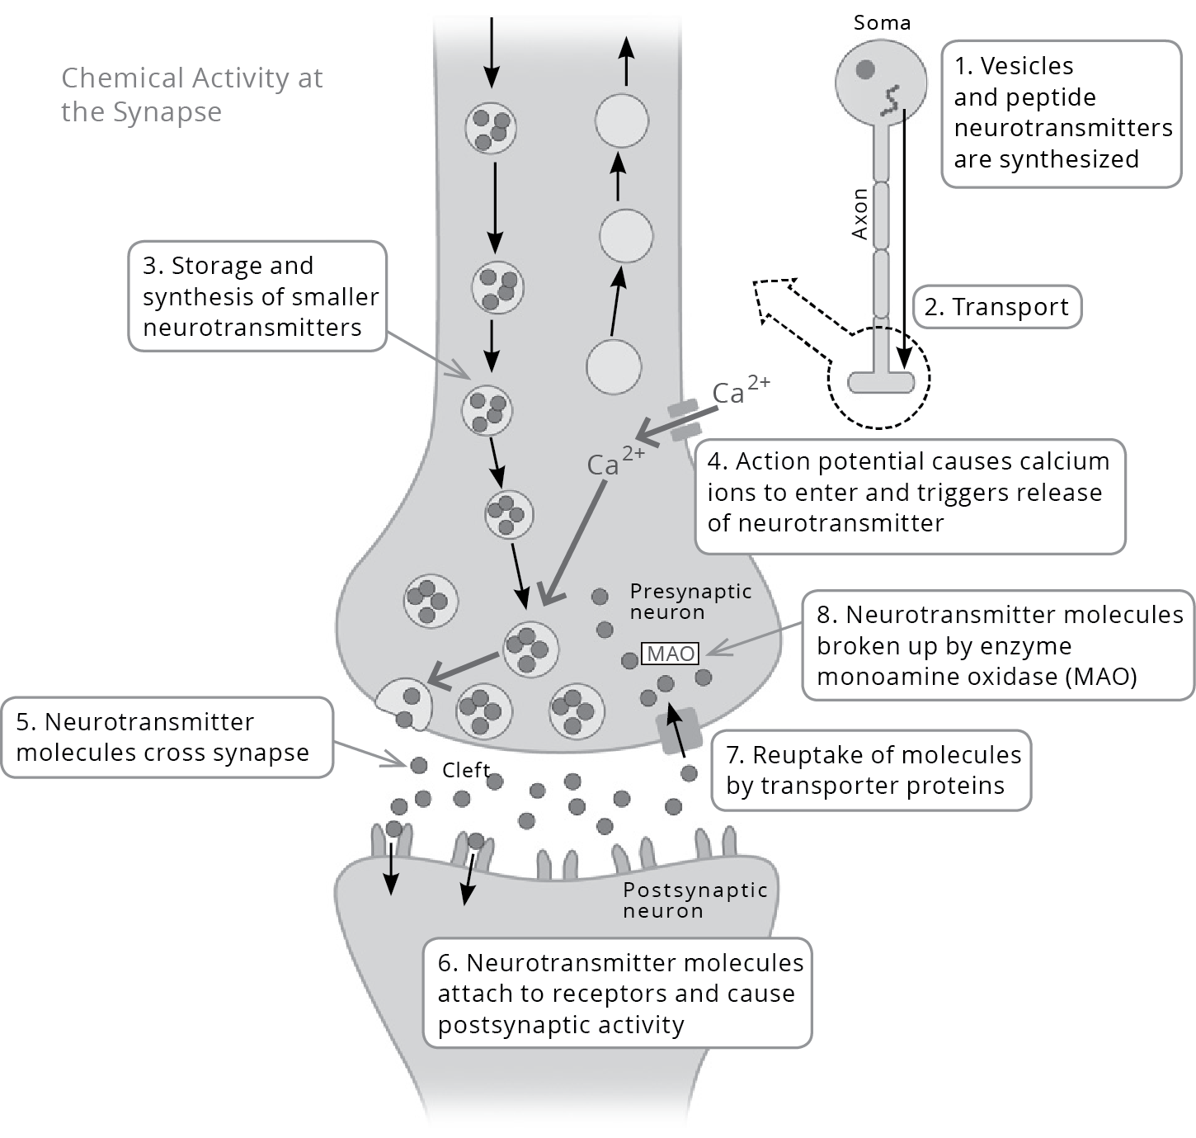
HOW NERVES
COMMUNICATE
Other types of neurotransmitters
Deficit of serotonin symptoms
Neurotransmitter deficiency or suboptimal nerve cell communication
Notes:
Of course, in addition to serotonin, there are many other types of neurotransmitters, including acetylcholine, norepinephrine, dopamine and gamma-amino butyric acid (GABA). But let’s say you have a neurotransmitter deficit of serotonin, which would compromise synaptic transmission of any nerve signals in your body that are dependent on serotonin. Similar to a deficit of neurotransmitters such as norepinephrine, epinephrine, and dopamine, this type of serotonin deficit can quickly create:
-Depression
-Appetite Cravings
-Brain Fog
-Low IQ
-Anxiety
-Panic Attacks
-Insomnia
-Eating disorders
-Migraines
-Ease of distraction or ADD
Millions of people walk around every day with some kind of neurotransmitter deficiency or suboptimal nerve cell communication. You’ve probably experienced at least one of these issues before, right? The good news is that you don’t have to check yourself into a mental institution. Here are 8 ways that you can fix these kind of neurotransmitter problems yourself.

Slide 10
8 WAYS TO FIX NEUROTRANSMITTER PROBLEMS
1
2
3
4
TAPER OFF OR AVOID ANTI-DEPRESSANTS
MODERATE STIMULANTS
AVOID TOXIN EXPOSURE
AVOID SENSORY OVERLOAD
5
6
7
8
FIX YOUR GUT
REPLACE BUILDING BLOCKS
NEURO-
TRANSMITTER REPLETION
LUBE THE NERVES WITH FATS

Slide 11
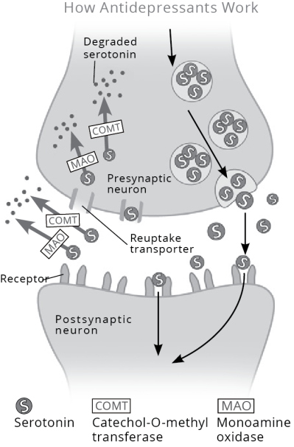
1. TAPER OFF OR AVOID ANTI-DEPRESSANTS
Why anti-depressants are such a problem
SSRI’s - Selective Serotonin Reuptake Inhibitors
Increasing dosages of anti-depressants required
Liver, kidneys and colon can become damaged by anti-depressant use
Notes:
1. Taper Off or Avoid Anti-Depressants
Prozac, Sarafem, Paxil, Zoloft, Celexa, Lexapro, Effexor, Cymbalta, Pristiq…the list of popular anti-depressant drugs goes on and on – with hundreds of millions of prescriptions handed out and billions of dollars in sales.
I wouldn’t even include this issue in the book unless I had personally done consults with many very active individuals who are either on anti-depressants, depressed, or showing signs of depression. Perhaps it’s the nature of the beast – us physically active people tend to rely on exercise for a high, and when that’s missing or we’re not fulfilled by it anymore, we can tend to get down. And at that point, anti-depressants may seem like an attractive solution.
Now I’m not a doctor and I’m not recommending that if you’re on an anti-depressant you quit cold turkey, but if you want to gradually taper yourself off these medications, you should certainly pay attention to the other 7 ways you can address neurotransmitter issues
Here’s why anti-depressants are such a problem: they work in one of two ways – either by increasing the brain levels of serotonin or they block re-uptake of serotonin. That is why most of them are called “SSRI’s”, or Selective Serotonin Reuptake Inhibitors.
These SSRI’s cause a short term “flooding” of the brain with serotonin, as well as a very fast degrading or breaking down of serotonin as it is left to hang around in the synaptic cleft.
As a result, not only are more and more levels of serotonin eventually required as serotonin receptors become desensitized to the constant flux of neurotransmitters, but there are also lower levels of naturally available serotonin as your biology begins to rely on external sources of the serotonin (1). When you do actually release your own serotonin, it winds up getting broken down far more quickly than normal, due to the fact that the enzymes in the synaptic clef have been “trained” to rapidly break down serotonin.
So you not only need constantly increasing dosages of anti-depressants, but you also end up depleting 40-60% of the serotonin receptors in your brain! In addition, the serotonin receptors in your liver, kidneys and colon can become damaged by anti-depressant use, which affects your delicate gut-brain balance and your regulation of appetite. It’s a vicious cycle!
There’s a great deal of evidence out there that anti-depressants don’t really work well anyways. Meta-analyses of studies on anti-depressants have revealed that SSRI’s have no clinically meaningful advantage over a placebo, and claims that anti-depressants are more effective in more severe conditions of depression have little evidence to support them. The few studies that have shown anti-depressants to have a small degree of superiority over placebo were poorly designed studies.
Ultimately, anti-depressants have not been convincingly shown to affect the long-term outcome of depression or suicide rates, and chronic exposure to SSRI antidepressants can actually make you feel apathetic or less engaged in your life.

Slide 12
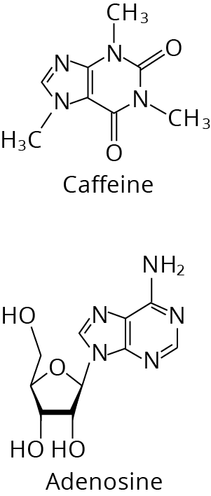
2. MODERATE STIMULANTS
Low dose vs high dose caffeine
Change the brain's chemistry and physical characteristics over time
Adenosine structure closely resembles caffeine
'Reset' your receptors with 7-12 days of caffeine avoidance
Notes:
2. Moderate Stimulants
Low dose caffeine can improve mental performance and protect against Alzheimer’s, so you don’t need to avoid it entirely (unless you are in a state of adrenal fatigue, which I discuss in Chapter 8) . But acting in a similar manner to anti-depressants, high doses of caffeine, ephedrine, ephedra, guarana, Ritalin, and any other central nervous system stimulant can flood the brain with neurotransmitters, creating neurotransmitter resistance or long term receptor damage (8).
There’s a reason that I personally drink no more than 8-10 ounces of black coffee each day, and switch to decaf for at least 1 week every couple month. People who use frequently use coffee, tea, soda or energy drinks actually change their brain’s chemistry and physical characteristics over time. Because it is both water and fat soluble, caffeine can easily cross your blood-brain barrier, and as you dump more and more caffeine into your body, your brain cells actually grow more receptors for a neurotransmitter called adenosine.
Adenosine causes feelings of tiredness, but as you can see below, the structure of caffeine closely resembles adenosine – so caffeine can easily fit into your brain cells’ receptors for adenosine. With it’s receptors constantly plugged up by caffeine, adenosine can no longer bind to those receptors and cause the feeling of tiredness (9). Unfortunately, your body’s response is to create more and more adenosine receptors – so you eventually need more and more caffeine to block the feeling of tiredness – and over time, you build up tolerance.
The good news is that to kick a caffeine habit and “reset” your adenosine receptors, you only need to get through about 7-12 days of caffeine avoidance, which is why I recommend taking week long breaks from coffee and

Slide 13

3. AVOID TOXIN EXPOSURE
Toxins affect product of neurotransmitters and sensitivity to neurotransmitters
Use organic fruits and vegetables, natural cleaning, natural personal care, home air and water filters and holistic dentistry
Notes:
3. Avoid Toxin Exposure
Whether it’s mycotoxins from moldy coffee, the fragrance of your cologne or perfume wafting into your nasal chambers, or the air freshener hanging your car, toxins affect product of neurotransmitters and sensitivity to neurotransmitters, causing brain damage, brain fog, and fuzzy thinking.
It’s probably not necessary for me to kick this horse to death much more than I did in Chapter 8 – “How To Protect Your Body From The 10 Hidden Killers In Your Home.“. Follow the rules there. To refresh your mind, a few of the biggies are:
-Use organic fruits and vegetables when possible (or wash them in a water and vinegar solution)
-Use natural cleaning chemicals (lemon juice, vinegar, baking soda etc.)
-Use natural personal care products (avoid parabens, dyes, fragrances, etc.)
-Use home air and water filters.
-Use holistic dentistry.
Once you begin to make these changes, you’ll find it very interesting that when you do encounter an attack against your neurotransmitters, such as walking through the fragrances section of a store in the mall, you’ll be extremely sensitive and notice it almost immediately. It’s important to your body in these situations. If it looks, tastes or smells synthetic, avoid it.

Slide 14

4. AVOID SENSORY OVERLOAD
Your brain needs to constantly modulate sensory bombardment
Calming neurotransmitters such as serotonin and GABA
Light, music, movies, games, clubs, etc.
Notes:
4. Avoid Sensory Overload
21st century sensory overload in the form of sounds, rapid visual and auditory effects from television, movies, computer games, electronic monitors flickering faster than the eye can detect, radio and EMF waves, fluorescent lighting, a hurried lifestyle, and excessive work all require your brain to constantly modulate these high levels of sensory bombardment that it would never have encountered in a more ancestral setting.
Your brain must calm itself down from all this stimuli using it’s own precious supply of calming, inhibitory neurotransmitters such as serotonin and GABA. This overstimulation has a significant impact on neurotransmitters and neurotransmitter receptors. So consider the following:
Do you listen to loud music while you’re exercising?
Do you have a steady diet of fast-moving, exciting or violent movies or video games, especially before bed?
Do you play lots of computer games, often for long periods of time, such as several hours?
Do you spend much of your day staring at a computer monitor?
Do you constantly have music such as the radio or streaming music stations playing in the background?
Does your home or workplace constantly have artificial, fluorescent lighting turned on?
If so, then go back and read the section in Chapter 8 on mitigating the effect of much of this EMF. Do not be afraid of silence, quiet and rest. Do not be afraid to unplug.
Take time to breathe.

Slide 15
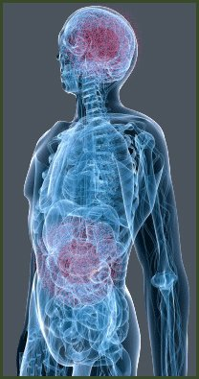
5. FIX YOUR GUT
The enteric nervous system in your gut uses more
than 30 neurotransmitters
IBS - too much serotonin in your gut and a neurotransmitter imbalance
Risk for neurotransmitters deficiencies and imbalances
Listen to your body, test, and fix the issues
Notes:
5. Fix Your Gut
As you learned in Chapter 15, your second brain is in your gut.
The enteric nervous system in your gut uses more than 30 neurotransmitters, just like the brain, and in fact 95 percent of the body’s serotonin is in the gut. This makes sense when you consider that in the nine meters from your esophagus to your anus, there are about 100 million neurons, more than in either your spinal cord or your entire peripheral nervous system!
This also explains why irritable bowel syndrome, something that afflicts nearly every active individual now and then, arises in part from too much serotonin in your gut – a neurotransmitter imbalance (as you can probably imagine, this is why anti-depressants can cause serious gut issues).
Not only does your gut lining produce neurotransmitters, but the billions of bacteria living in your gut also churn out neurotransmitters. So if your gut lining is damaged or your gut flora is out of balance, then you are at serious risk for neurotransmitters deficiencies and imbalances.
The best step you can take to fix these gut-brain issues have already been spelled out in Chapter 15 – listen to your body, test, and fix the issues. Everything you need to do it is in that chapter.
Read more http://www.bengreenfieldfitness.com/2013/08/how-to-fix-your-brain/

Slide 16
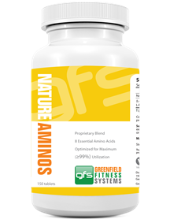
6. REPLACE BUILDING BLOCKS
Neurotransmitters are primarily comprised of amino acids, vitamin B, and minerals
The best high quality amino acid sources
Adequate intake of B complex vitamins, and Vitamins B6, B12 and folate
Include a rich source of protein if you are under high amounts of exercise or lifestyle stress
Notes:
6. Replace Building Blocks
Neurotransmitters are primarily comprised of amino acids, vitamin B, and minerals. A deficiency of any of these three crucial compounds can leave you with inadequate neurotransmitter building blocks.
As you learned in Chapter 5, some of the best high quality amino acid sources include grass-fed beef, wild salmon, eggs from pastured chickens, raw organic dairy, almond and almond butter, quinoa, and spirulina or chlorella sources. I’ve found that many people who struggle with sleep issues or motivation issues that are tied to neurotransmitter issues also benefit from the use of essential amino acids. When I’m about to head into a workout that I know threatens to beat up my brain with intense levels of focus or competition, I usually take 5-10 grams of Master Amino Pattern, which is an optimally-balanced blend of all 8 essential amino acids.
In order for the nervous system to synthesize and circulate the neurotransmitters formed by amino acid precursors, you need to have adequate intake of B complex vitamins, and Vitamins B6, B12, and folate are especially important in nerve metabolism. Excellent food sources of vitamin B6 include bell
peppers, turnip greens, and spinach; excellent sources of folate include spinach, parsley, broccoli, beets, turnip and mustard greens, asparagus, romaine lettuce, calf’s liver, and lentils, and excellent sources of B12 include calf’s liver and snapper. For Vitamin B supplementation, I recommend either a liposomal Vitamin B12 spray, or an antioxidant/Vitamin B powdered blend.
You’ll get very good doses of minerals from a well balanced diet that includes a broad spectrum of the real foods and nutrient dense sources listed in Chapter 11. But if you’re frequently sweatiing or under high amounts of exercise or lifestyle stress (remember that adrenal stress depletes minerals), then you should also include a mineral rich source of protein such as a goat-based protein powder (goat protein is higher in minerals), and a daily dose of either a trace liquid mineral supplement and liberal use of a high quality salt, such as Himalayan sea salt.

Slide 17
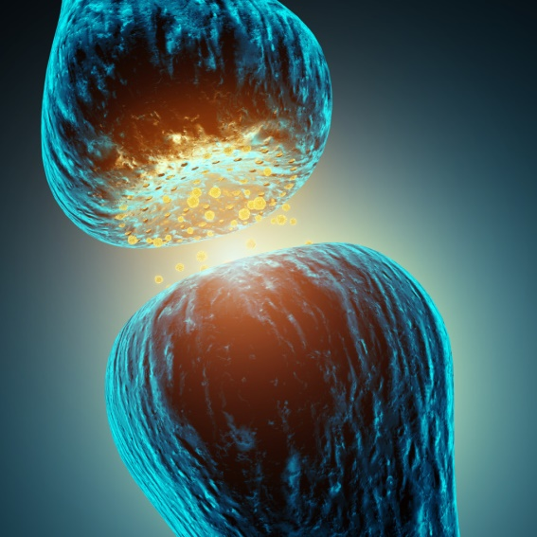
7. NEUROTRANSMITTER REPLETION
Neurotransmitter repletion via amino acid therapy
One example with an amino acid blend
NeuroReplete, CysReplete and D-5 Mucuna
Dr. Daniel Kalish
Testing your neurotransmitter levels
Notes:
7. Neurotransmitter Repletion
Often, simply eating adequate protein or using essential amino acids supplements is not enough. This can be the scenario in cases of depression, insomnia or severe lack of motivation. In these cases, neurotransmitter repletion via amino acid therapy is something that can be effective, but should ideally be done under medical supervision, because unless you use the proper ratios, you can actually worsen neurotransmitter imbalances and make issues worse – even if you might feel better temporarily.
One example of neurotransmitter repletion with an amino acid blend that can be helpful for insomnia, depression or lack of motivation is taking 3000mg Tyrosine and 300mg 5-HTP, split into three daily doses. There are several supplements that actually include Tyrosine and 5-HTP in the exact ratios you need them, including Travacor by Nutriscience (my preferred blend), Neuro-5HTP by Biotics and CraveArrest by Designs For Health.
Another example of neurotransmitter repletion would be using a supplement called NeuroReplete to balance catecholamines and increase serotonin then combining it with CysReplete to increase catecholamine synthesis and D-5 Mucuna to increase dopamine synthesis. This gets a little more advanced than the options above, so keep reading for the warning and disclaimer.
You shouldn’t just jump into this repletion without knowing what you are doing. For example, taking only 5-HTP or improperly balanced 5-HTP can deplete dopamine. Taking only L-dopa or improperly balanced L-dopa depletes serotonin, sulfur-based amino acids, L-tryptophan, and tyrosine. Administration of high amounts of sulfur-based amino acids can deplete serotonin and dopamine.
Dr. Daniel Kalish is a real expert when it comes to neurotransmitter repletion therapy, and I’d highly recommend you visit the Kalish Institute website, read the Kalish Method book or speak with a licensed Kalish practitioner prior to experimenting too much with this stuff. Another very good resource to learn more about neurotransmitter repletion is NeuroAssist.com.
You can actually test your neurotransmitter levels if you want to see what you might be deficient in. The test I recommend is available from DirectLabs and is the NeuroAdrenal Expanded test. It will screen for the salivary hormones DHEA and Cortisol, along with urinary neurotransmitters Epinephrine, Norepinephrine, Dopamine, DOPAC, Serotonin, 5HIAA, Glycine, Taurine, GABA, Glutamate, PEA, and Histamine.
Finally, if you are interested in how to combine a highly accurate, gold-standard form of urinary neurotransmitter testing with neurotransmitter repletion, I’d recommend you check out LabDBS.com,
Read more http://www.bengreenfieldfitness.com/2013/08/how-to-fix-your-brain/

Slide 18
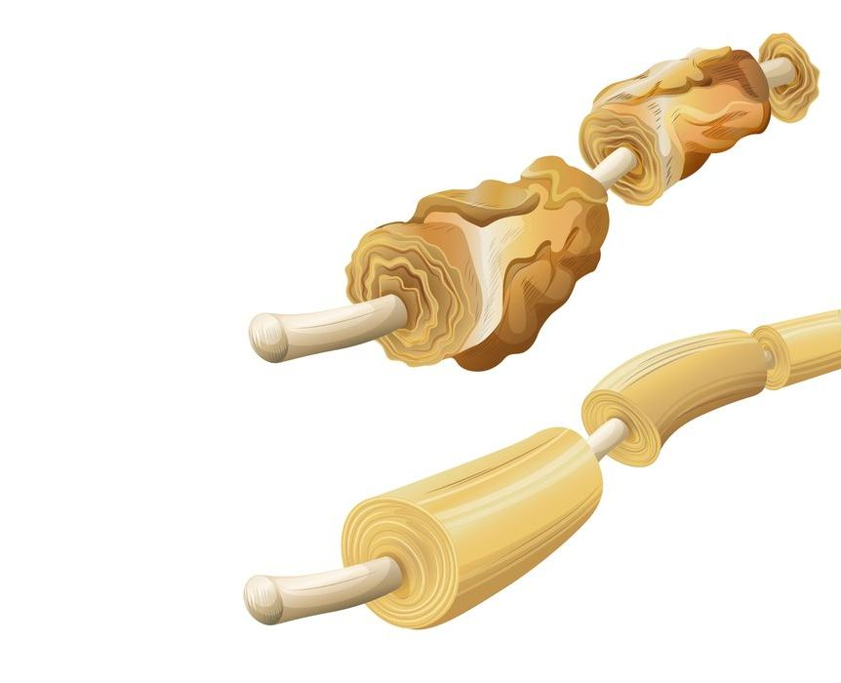
8. LUBE THE NERVES WITH FATS
Nerves are wrapped in myelin sheaths
Omega-3 fatty acids and docosahexaenoic acid (DHA)
Food sources of omega-3 fatty acids
Algae-based DHA supplements such as chlorella, spirulina EnergyBits or marine phytoplankton
Notes:
8. Lube The Nerves With Fats
In Chapter 4, you learned that one of the ways to enhance the speed with which your brain communicates with your body and muscles is to care for the health of your nerves. Your nerves are wrapped in sheaths called myelin sheaths, and a diet for a healthy nervous system should be comprised of specific nutrients that support the formation of these myelin sheaths, and also the health of the nervous system as a whole.
After all, it doesn’t matter how many neruotransmitters you make if the action potentials they are propagating can’t be adequately transmitted because you have broken down, degraded myelin sheaths.
For this reason, I not only recommend following the fat percentage intake recommendations from Chapter 13, but I also recommend including a high intake of omega-3 fatty acids, especially docosahexaenoic acid (DHA). DHA is particularly important in building the myelin sheath structure and preventing degrading and breakdown of nerve cells.
Flax seeds, walnuts, kale collard greens, and winter squash are excellent sources of omega-3 fatty acids, but the amount of DHA actually absorbed from seeds, nuts and plants can be relatively low. Better sources of more readily available omega-3 fatty acids and DHA include salmon, sardines, cloves, grass-fed beef, halibut, shrimp, cod, tuna and (especially for vegans or vegetarians), algae-based DHA supplements such as EnergyBits or marine phytoplankton. Other foods that support neuronal membranes and myelin sheath health due to their high content of oleic acids include olive oil, almonds, pecans, macadamias, & avocados.

Slide 19
1
Avoid anti-depressants
Modulate stimulants
Avoid toxins
Avoid sensory overload
Fix your gut
Replace building blocks
Eat healthy fats
HOW TO
FIX YOUR NEUROTRANSMITTERS
SUMMARY
Notes:
Summary
So there you have it: avoid anti-depressants, modulate stimulants, avoid toxins, avoid sensory overload, fix your gut, replace building blocks, eat healthy fats, and, if necessary, replete with neurotrasmitter therapy. You now know how to enable your nerve cells to be highly tuned communicators, ready to listen and respond appropriately to the commands from your brain. Not surprisingly, many of the strategies above are similar to the type of strategies you learned in Chapter 4, and can be used not just to increase focus, decrease distractions, or feel better, but also to enhance highly nervous system dependent systems in your body such as power and speed.
In the next chapter, you’re going to learn how to fix the second way that your brain breaks – HPA axis dysfunction. But in the meantime, leave your questions, comments and feedback about motivation, the central governor, fatigue and neurotransmitters below, and I promise to reply!
Read more http://www.bengreenfieldfitness.com/2013/08/how-to-fix-your-brain/

Slide 20
1
2
3
HOW TO
FIX YOUR NEUROTRANSMITTERS
HOW TO
FIX HPA AXIS DYSFUNCTION
HOW TO INCREASE YOUR BRAIN POWER

Slide 21
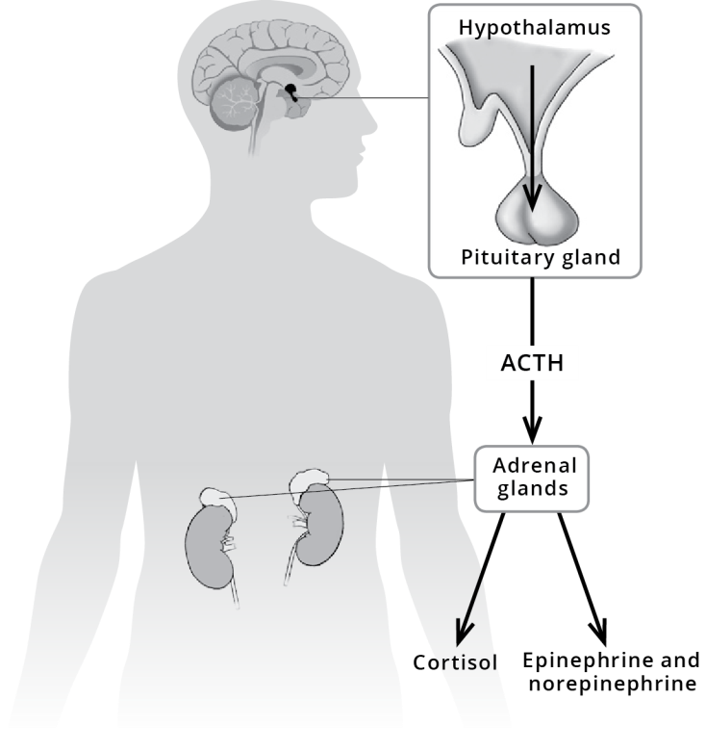
WHAT IS HPA AXIS DYSFUNCTION?
The HPA axis includes hypothalamus, the pituitary and the adrenal
These regulate functions such as
stress response, mood, digestion, immune system, libido, metabolism and energy levels
Notes:
What Is HPA Axis Dysfunction?
The HPA axis includes three specific parts of your body:
1) the hypothalamus (part of your forebrain);
2) the pituitary gland (just below the hypothalamus);
3) the adrenal glands (at the top of the kidneys).
These three parts work together to regulate functions such as stress response, mood, digestion, immune system, libido, metabolism and energy levels. Before understanding how to fix your HPA axis, it’s important to understand how the axis works in the first place, so let’s dive into the specific chemicals utilized by your HPA axis.
1. Corticotropin-Releasing Hormone (CRH)
Also referred to as corticotropin-releasing factor (CRF), this hormone is produced and secreted by the hypothalamus in response to stress, and it then stimulates your pituitary gland to secrete adrenocorticotropic hormone. The more stressed your body is (from diet, lifestyle, work, or anything else) the more CRH your hypothalamus will churn out.
2. Adrenocorticotropic Hormone (ACTH)
ACTH is released by the pituitary gland, and travels to your kidneys to stimulate the adrenal glands to increase production of glucocorticoids.
3. Glucocorticoids
The glucocorticoids produced in the adrenal glands are steroids that are necessary regulating metabolic rate, inflammation and immune response. You’ve already learned about the most notorious glucocorticoids: cortisol.
4. Cortisol
Cortisol is best known for activating our physical response to stress, including injury, lack of sleep, excessive exercise, anxiety, and depression. It prepares your body to withstand these stressful triggers by stimulating norepinephrine (also known as noradrenaline) to active your fight-and-flight reaction.
It’s important to understand is that your HPA axis operates on feedback loops. A feedback loop occurs when the output of a system in your body somehow loops back to that system as input, and influences its functioning. A positive feedback loop would increase that system’s output, and a negative feedback loop would decrease it.
So let’s take a look at how a feedback loop would take place in the HPA – in this case with regards to cortisol. At the same time that cortisol activates your fight and flight stress response, it also sends a signal back to your hypothalamus to inhibit CRH production and your pituitary gland to inhibit ACTH. In this feedback loop, cortisol is also able to reduce norepinephrine activity, gradually calming you down and creating a well-functioning checks-and-balances system (3).
In healthy, low-stress individuals this entire HPA axis feedback loop works in harmony. But when cortisol and norepinephrine are chronically overproduced, the HPA axis eventually becomes desensitized to the negative feedback telling it to “calm down”, leading to chronic stress on the hypothalamus, pituitary gland and adrenal glands. Eventually, this leads to the neural failure that eventually causes all the nasty adrenal fatigue issues you learned about in Chapter 6, Chapter 7 and Chapter 8, and it is called HPA axis dysregulation (5).
Interestingly, HPA axis dysregulation is 100% linked to the neurotransmitter imbalance issue you learned about earlier in this chapter. For example, selective serotonin reuptake inhibitor anti-depressants can actually be very effective at treating panic issues. This is because as as serotonin levels rise, levels of norepinephrine fall. Of course, as you also learned earlier, this is not the best way to treat stress, since you’ll simply need more and more anti-depressants as time goes on, and your body becomes desensitized to serotonin (2). But it is a good way to point out the fact that as your neurotransmitter production becomes enhanced, you become more equipped to fix HPA axis dysfunction.
Below are 4 additional ways that you can fix HPA axis dysfunction.
Read more http://www.bengreenfieldfitness.com/2013/08/how-to-fix-hpa-axis-dysfunction/

Slide 22
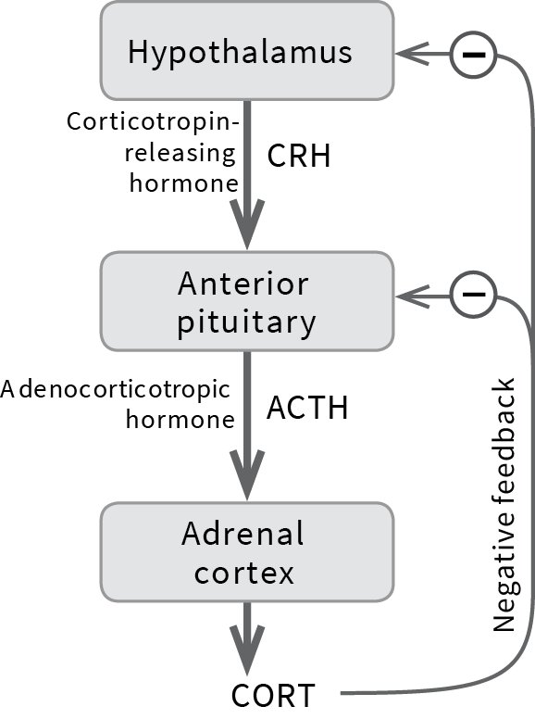
WHAT IS HPA AXIS DYSFUNCTION?
CRH, ACTH, Glucocorticoids and Cortisol
HPA axis operates on feedback loops
When Cortisol and Norepinephrine are chronically overproduced, the HPA axis becomes desensitized
HPA axis dysregulation is 100% linked to neurotransmitter imbalance
Notes:
What Is HPA Axis Dysfunction?
The HPA axis includes three specific parts of your body:
1) the hypothalamus (part of your forebrain);
2) the pituitary gland (just below the hypothalamus);
3) the adrenal glands (at the top of the kidneys).
These three parts work together to regulate functions such as stress response, mood, digestion, immune system, libido, metabolism and energy levels. Before understanding how to fix your HPA axis, it’s important to understand how the axis works in the first place, so let’s dive into the specific chemicals utilized by your HPA axis.
1. Corticotropin-Releasing Hormone (CRH)
Also referred to as corticotropin-releasing factor (CRF), this hormone is produced and secreted by the hypothalamus in response to stress, and it then stimulates your pituitary gland to secrete adrenocorticotropic hormone. The more stressed your body is (from diet, lifestyle, work, or anything else) the more CRH your hypothalamus will churn out.
2. Adrenocorticotropic Hormone (ACTH)
ACTH is released by the pituitary gland, and travels to your kidneys to stimulate the adrenal glands to increase production of glucocorticoids.
3. Glucocorticoids
The glucocorticoids produced in the adrenal glands are steroids that are necessary regulating metabolic rate, inflammation and immune response. You’ve already learned about the most notorious glucocorticoids: cortisol.
4. Cortisol
Cortisol is best known for activating our physical response to stress, including injury, lack of sleep, excessive exercise, anxiety, and depression. It prepares your body to withstand these stressful triggers by stimulating norepinephrine (also known as noradrenaline) to active your fight-and-flight reaction.
It’s important to understand is that your HPA axis operates on feedback loops. A feedback loop occurs when the output of a system in your body somehow loops back to that system as input, and influences its functioning. A positive feedback loop would increase that system’s output, and a negative feedback loop would decrease it.
So let’s take a look at how a feedback loop would take place in the HPA – in this case with regards to cortisol. At the same time that cortisol activates your fight and flight stress response, it also sends a signal back to your hypothalamus to inhibit CRH production and your pituitary gland to inhibit ACTH. In this feedback loop, cortisol is also able to reduce norepinephrine activity, gradually calming you down and creating a well-functioning checks-and-balances system (3).
In healthy, low-stress individuals this entire HPA axis feedback loop works in harmony. But when cortisol and norepinephrine are chronically overproduced, the HPA axis eventually becomes desensitized to the negative feedback telling it to “calm down”, leading to chronic stress on the hypothalamus, pituitary gland and adrenal glands. Eventually, this leads to the neural failure that eventually causes all the nasty adrenal fatigue issues you learned about in Chapter 6, Chapter 7 and Chapter 8, and it is called HPA axis dysregulation (5).
Interestingly, HPA axis dysregulation is 100% linked to the neurotransmitter imbalance issue you learned about earlier in this chapter. For example, selective serotonin reuptake inhibitor anti-depressants can actually be very effective at treating panic issues. This is because as as serotonin levels rise, levels of norepinephrine fall. Of course, as you also learned earlier, this is not the best way to treat stress, since you’ll simply need more and more anti-depressants as time goes on, and your body becomes desensitized to serotonin (2). But it is a good way to point out the fact that as your neurotransmitter production becomes enhanced, you become more equipped to fix HPA axis dysfunction.
Below are 4 additional ways that you can fix HPA axis dysfunction.
Read more http://www.bengreenfieldfitness.com/2013/08/how-to-fix-hpa-axis-dysfunction/

Slide 23
4 WAYS TO FIX HPA AXIS DYSFUNCTION
1
2
3
4
DESTRESS
AVOID EXCESSIVE EXERCISE
SHUT DOWN INFLAMMATION
SLEEP

Slide 24

1. DESTRESS
Shield the brain from stress
Avoid FOMO and All-Or-Nothing
Avoid people with negative energy
Breathing, meditation, tai chi, yoga, coherence,
a hobby and high quality sleep
Notes:
1. Destress
I like to think of myself as “stress selfish”. In other words, I guard my brain fairly intensively when it comes to shielding it from stress. I go to bed several minutes earlier than necessary so that when I wake up, I don’t need to bolt upright out of bed and rush to my first task. If work gets extremely stressful and I find myself shallow breathing, I go for a walk, or even go lie on the bed, the floor or a couch and do several minutes of deep breathing. I purposefully avoid speaking with people from whom I get “negative energy”. All these little steps add up to protected my HPA axis.
So what else can you do to destress?
Flip back to Chapter 7. There you will see a big list of all the various daily stresses that can disrupt the HPA axis, from scheduling stress to relationship conflicts to poorly designed training equipment or subpar training conditions.
In Chapter 9, (The 7 Best Stress-Fighting Weapons That Will Make Your Mind-Body Connection 100% Bulletproof) you learn that breathing, meditation, tai chi, yoga, coherence, a hobby and high quality sleep are all extremely effective ways to de-stress.
Read more http://www.bengreenfieldfitness.com/2013/08/how-to-fix-hpa-axis-dysfunction/

Slide 25

2. AVOID EXCESSIVE EXERCISE
Overtraining is one of the quickest paths to
HPA Axis dysfunction
Use HRV to monitor
Periodize and program
Liquid trace minerals or Himalayan sea salt,
whole foods Vitamin C source, fish oil, adaptogenic herbs
Notes:
2. Avoid Excessive Exercise
Overtraining is one of the quickest paths to HPA Axis dysfunction, and leads to many of the brain fog, mood and irritability issues experienced by many athletes, especially endurance athletes.
In my podcast interview with Dr. Sara Gottfried “The Cost Of Being A Bad-Ass – How To Cure Your Hormones With Dr. Sara Gottfried“, Dr. Sara explains how excessive exercise chronically elevates cortisol levels, and tells you what you can do about it. I spell all this out in detail in Chapter 6, Chapter 7 and Chapter 8.
If you’ve created high cortisol levels from high amounts of exercise, revisit those chapters. Follow the recovery protocols, and also consider supplementation with Chinese Adaptogenic Herbs such as TianChi or InnerPeace, high electrolyte intake, preferably with liquid trace minerals or Himalayan sea salt, 2,000 to 5,000 milligrams of a whole foods Vitamin C source, and 4-6g per day of a good fish oil that preferably contains vitamin E with mixed tocopherols.
I also recommend you check out the Pacific Elite Fitness Hormone Pack, which I personally designed as a means of promoting hormone stabilization and hormone balance in a gentle and natural manner, without the use of pharmaceutical or synthetic hormone replacement therapy. It is comprised of a bottle of trace liquid minerals, a bottle of fish oil, and a box of Chinese Adaptogenic Herbs. If you’ve been engaged in excessive exercise, this can help bring your HPA axis back into balance.
———————————–

Slide 26

3. SHUT DOWN INFLAMMATION
Curcumin
NF-kB study in mice
Elevated cortisol levels can also cause
systemic inflammation
Fish oil, cold thermogenesis, pulsed electromagnetic field therapy
Notes:
3. Shut Down Inflammation
When I wake up with a “fuzzy brain” (which can happen after a late night out, too much alcohol, or getting sleep disrupted during the night), one of the first things I do is pop 1000mg of curcumin from Phenocane, which can rapidly shut down inflammation and mitigate the effect of a poor night’s sleep on the HPA axis. This is because curcumin is a potent anti-inflammatory.
Decreasing inflammation is a potent HPA axis protecting and repair strategy. In mice, researchers have experimented with a protein involved in inflammation in the hypothalamus called NF-kB. When NF-kB is switched off in the hypothalamus of the mice, they lived about 20% longer (6). On the flip side, increasing NF-kB not only accelerates aging, but also decreases an important another important brain protein called GnRH. When GnRH is turned down, fewer new brain cells are created, and aging is accelerated even more (1).
This is just one example of how inflammation can affect the HPA axis. Elevated cortisol levels can also cause systemic inflammation (and vice versa), which further aggravates the HPA axis.
As you learned in Chapter 8, maximizing intake of anti-inflammatory foods and minimizing pro-inflammatory foods is just one step toward controlling inflammation, and from fish oil to cold thermogenesis to pulsed electromagnetic field therapy, there are a couple dozen other strategies in that chapter that will decrease inflammation. Most of those anti-inflammatory protocols work not only on the muscles, but also on the HPA axis.

Slide 27

4. SLEEP
Neurons and nerve cells repair between 2am and 6am
The single most important strategy to fix your HPA axis
Sleep hygiene and sleep selfishness
Notes:
4. Sleep
In Chapter 7, “The Last Resource You’ll Ever Need To Get Better Sleep, Eliminate Insomnia, Beat Jet Lag and Master The Nap” you learn that the only time your body actually repairs neurons and nerve cells is when you are sleeping – especially during deep sleep stages that occur as your body temperature decreases between 2am and 6am.
So if you’re attempting to fix your HPA axis and you’re not getting quality sleep, then you’re never going to fully recover and repair.
As a matter of fact, because of the crucial role that sleep plays in the health of your nervous system, getting adequate sleep is the single most important strategy you could ever implement for fixing your brain and enhancing your mental function.
Even if you incorporate all of the biohacks you’ll learn about in the next chapter, you’re never going to experience 100% optimal nerve and brain performance if you aren’t sleeping properly – and this is all the more true the evening of any day you’re doing hard workouts. In the same way that you need to be selfish with stress, you need to be selfish with sleep.

Slide 28
2
Destress
Avoid excessive exercise
Shut down inflammation
Sleep
HOW TO
FIX HPA AXIS DYSFUNCTION
SUMMARY
Notes:
Summary
At this point in your reading, you shouldn’t be surprised by the four best strategies to fix your HPA axis: de-stress, avoid excessive exercise, shut down inflammation and sleep (Holtorf). You saw these strategies in the recovery chapter too – and there’s a reason for that: the more you break down the body the more fragile your brain becomes.
All four of the fixes you’ve just learned about are interrelated and codependent, and if you get each of them dialed in, your hypothalamic-pituitary-adrenal feedback loops will work with wonderful efficiency.
In the next chapter, you’re going get an amazing array of tools, tricks and tips to tune your mind, hack your brain, boost your IQ, enhance your focus and instantly get into the coveted, effortless zone of peak performance.
In the meantime, leave your questions, comments and feedback below!
Read more http://www.bengreenfieldfitness.com/2013/08/how-to-fix-hpa-axis-dysfunction/

Slide 29
1
2
3
HOW TO
FIX HPA AXIS DYSFUNCTION
HOW TO
FIX YOUR NEUROTRANSMITTERS
HOW TO
FIX HPA AXIS DYSFUNCTION
HOW TO INCREASE YOUR BRAIN POWER

Slide 30
Not including any potentially harmful or unproven in long term studies
\
Any drugs, supplements, nutraceuticals, and functional foods that improve mental functions
Either fat soluble compounds or dependent on fat for their absorption or proper utilization
NOOTROPICS
Notes:
Nootropics
The word nootropics is used to define any drugs, supplements, nutraceuticals, and functional foods that improve mental functions such as cognition, memory, intelligence, motivation, attention, and concentration (4).
In this section, I am purposefully not going to include any nootropics that are potentially harmful, unproven in long term studies, give you a biological free pass that you may possibly regret in the future, or are banned by sporting organizations due to their potential to overstimulate your cardiovascular system. This includes compounds such as Aniracetam, Modafinil, Centrophenoxine, Picamilon or Sulbutiamine. If you want to explore these, I’d highly recommend you grab the free online manual The Limitless Pill, which was written by Mark Joyner, who was a guest on the podcast episode, “Are Your Expensive Multivitamins Even Absorbed…Or Are There Better Ways To Deliver Precious Nutrients To Your Body?“
In addition, you’ll notice a repeating pattern with many of the items listed below – they are either fat soluble compounds or they are dependent on fat for their absorption or proper utilization. In other words, it doesn’t matter how many brain-hacking nutrients you take if you’re eating a low fat diet or shooting for a low blood cholesterol value. So go back and read Chapter 13 and adjust your diet accordingly if necessary.

Slide 31


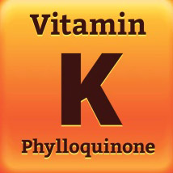
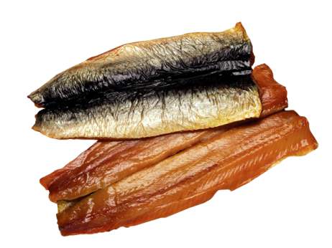
NOOTROPICS
VITAMIN D
VITAMIN K2
FATTY
ACIDS
PHOSPHATIDYL
SERINE
prevents neuron damage
vegans and vegetarians
natural sources better
central nervous system
cognitive function
memory-enhancement
neurological health
nerve transmission
found in neural tissue
cognitive performance and memory
high levels in seafood
Notes:
1) Vitamin D
Within the pages of this book, I’ve praised the efficacy of Vitamin D for everything from boosting hormone levels to promoting bone health. But there are actually receptors for Vitamin D in the central nervous system and in the hippocampus (memory and spatial recognition) region of your brain. In these areas, Vitamin D not only protects neurons, but also regulates enzymes in your brain and cerebrospinal fluid that are involved in neurotransmitter synthesis and nerve growth (3).
One recent study investigating Vitamin D and cognitive function found that the lower your Vitamin D levels, the more negative your performance is on mental tests. Another study fund that people with lower vitamin D levels have slower ability to process information – with this effect even more pronounced in individuals older than 60.
It’s important to understand that when it comes to Vitamin D, none of the strategies I’m about to give you will hold a candle to daily sunlight exposure combined with adequate fat intake. But to get the memory-enhancement effect of increased Vitamin D (especially if you live in a northern climate or get limited sun exposure) include a few teaspoons of cod liver oil frequently in your diet, eat beef and butter, have calf’s liver now and then, and take approximately 2000-4000 daily international units (IU) of Vitamin D, preferably from a highly absorbable liquid source, such as a spray or an oil.
When it comes to Vitamin D, there can be a law of diminishing returns, so I highly recommend you pair Vitamin D testing with your intake, and keep your levels between 40 and 80 ng/ml. Finally, if you’re a vegetarian or vegan or eating inadequate amounts of fat, do not just take a bunch of D, because it can be toxic unless you pair it with A and K.
——————————————–
2) Vitamin K2
Your brain contains one of the highest concentrations of vitamin K2 in your entire body, and it is in this area of your body that Vitamin K2 prevents free radical damage to neurons and contributes to the production of the protective “myelin” sheets around your brain cells.
In this book, I have already discussed Vitamin K2 in Chapter 14 as a very important supplement for vegans and vegetarians, Vitamin K2 is a relatively new darling on the supplement front, and many folks are rushing out to buy and use it for it’s bone building, brain building, and other remarkable benefits (2). But the fact is, unless you are vegan or vegetarian, or you have a serious deficiency or disease that requires K2 intake, you’re better off getting your K2 from natural sources such as grass-fed beef, fermented dairy products (like kefir) and natto (a fermented soybean derivative). Go back and read Chapter 14 if you want to learn more about K2 supplements and dosage.
——————————————–
3) Fatty Acids
A substance called “arachidonic acid” is one of the most abundant fatty acids in the brain, and is crucial your neurological health, since it helps build the cell membranes in your hippocampus, helps protect your brain from free radical damage, and activates proteins that are responsible for growth and repair of neurons in your brain (5). In one study, 18 month old infants who were given arachidonic acid supplements for 17 weeks showed significant improvements in intelligence, and in adults impaired arachidonic acid metabolism or insufficient arachidonic acid intake is linked to brain issues such as Alzheimer’s and bipolar disorder.
In my opinion, it would be silly to supplement with arachidonic acid since it is readily available in food sources, including Tilapia, catfish, yellowtail and mackerel (sushi anyone?), fatty cuts of meat, duck, eggs and dairy. If you want a better brain, you should frequently go out of your way to get your chompers on fatty foods.
Incidentally, this highlights a reason why very active women need to be careful not to let their body fat levels fall too low if they plan on having children. Hip and butt fat are full of the the specific omega-3 fatty acids and DHA necessary for major brain development during the development of a baby, and if women are low on body fat and low in DHA, this will severely compromise intelligence in the baby.
——————————————–
4) Phosphatidylserine
Compared to other similar triglycerides and dietary fats, phosphatidylserine is found in abundance in neural tissue, where it serves as a structural component of cell membranes, and acts to increase your available acetylcholine levels (more on why that’s a good thing later) (12).
Phosphatidylserine has been shown to improve memory and spatial recognition in rats, and may also improve cognitive performance and memory in humans, although the majority of studies have been done in elderly individuals (where phosphatidylserine has been shown to be beneficial in decreasing progression of Alzheimer’s disease and dementia).
Although you can find phosphatidylserine in supplement and pill forms (especially in the form of krill oil), it tends to be expensive, especially when you consider that you can get it in fairly high levels in seafood, particularly herring and mackerel. Perhaps you’re seeing a pattern here that it might be a good idea to become a fan of sushi and sashimi if you’re aren’t already including in your diet – or at least start getting some good canned herring or mackerel to put on your salad every now and again.

Slide 32

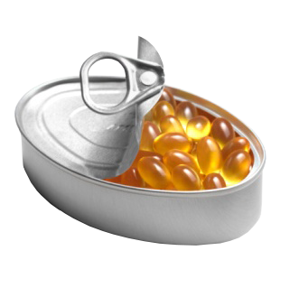


NOOTROPICS
FISH OIL
MCTs
CAFFEINE
L-THEANINE
omega-3 fatty acids
improving mental function
triglyceride based
generates ketones
significant cognitive boosts
BHB
improve memory recall
more caffeine is not better
disorders
green tea and black tea
reducing stress and anxiety
mix with caffeine
Notes:
5) Fish Oil
As you learned in the last chapter, signals used in thought, memory and processing bounce around in your brain and get transferred from one brain cell (neuron) to another via a point called a synapse, where the signals cross a physical channel before moving on to the next neuron. The walls that these signals need to pass through are comprised of cell membranes made up of about 20% essential fatty acids – like the omega-3 fatty acids found in fish oil.
Specifically, these Omega-3 fatty acids may make the membrane that holds these channels more elastic, making it easier for the channels to change shape and for signals to propagate throughout your nervous system. With inadequate Omega-3 fatty acids, these channels lose flexibility and electrical impulses become hindered. Inadequate fatty acids may also harm the function of structures called G-proteins, which are the inside the cell membrane and of vital importance to the transmission of signals between brain cells.
With as little as 2 grams per day, the use of omega-3 fatty acids like fish oil may also reduce severity of dyslexia and attention deficit hyperactivity disorder (ADHD), Alzheimer’s, brain atrophy and cognitive decline, while simultaneously improving mental function (17).
Don’t waste your money on cheap, ethyl-ester forms of fish oil that you’ll find in most supplements. Instead, pair 1-2 grams of a daily dose of triglyceride based fish oil with regular intake of cold-water fish like mackerel, herring, anchovies or sardines. It’s also a good idea to consume a fish oil that includes antioxidants such as astaxanthin, Vitamin D and Vitamin E, and to also step up dark, leafy green and dark fruit intake, or include a good antioxidant supplement. This is all the more important if you decide to “mega-dose” with 8-10g of fish oil per day (which I personally do on any day I’m not eating fish).
——————————————–
6) MCT‘s
When your body burns fatty acids as a fuel, it produces an end-product called Acetyl-CoA. Acetyl-CoA is then converted into ketones, which are a fuel that is preferentially used by your brain. At high enough levels of blood ketones, you begin to experience significant cognitive boosts and an increase in focus, which is one of my reasons for including ketosis as a dietary performance strategy in Chapter 14.
One of the quickest ways to generate ketones from fatty acids is via the use of a special kind of fat called medium chain triglycerides, or MCT’s (9). While you can get ample MCT’s from coconut oil, you can get them in an even more purified and concentrated form from liquid MCT oil.
MCT’s are easy to use. You can blend several tablespoons of MCT oil with the coffee recipe you’ll find below or you can eat a couple tablespoons of coconut oil in the mid-morning or the mid-afternoon. Too many MCT’s can easily cause an upset stomach, so start small, and gradually titrate your dosage up.
Interestingly, although at the time of this writing, it has yet to be approved by the FDA, a special kind of ketone called “BHB” is sold in the form of beta-hydroxy-butyrate salts and can instantly increase levels of blood ketones without you needing to consume any fat at all. This could be an interesting supplement to keep an eye on, and I suspect it will become mainstream very soon.
——————————————–
7) Caffeine
100mg of caffeine, which is close to the amount you’ll get in a cup of black coffee, has been proven to improve memory recall (11). Caffeine’s psychostimulatory effects are primarily because it blocks a receptor in your central nervous system that is responsible for binding a compound called adenosine. When you inhibit adenosine, you get increased activity of dopamine and glutamate, two feel-good, alertness-increasing brain-stimulating compounds.
However, as you learned in the previous chapter, more caffeine is not better, since higher doses may decrease blood flow to your brain, and you can quickly build up tolerance. Furthermore, at least three caffeine-induced disorders are recognized by the American Psychiatric Association: caffeine intoxication, caffeine-induced sleep disorder and caffeine-induced anxiety disorder. Furthermore, you need to choose fresh coffee from arabica beans, and not coffee powders or substitutes, since cheap coffee and coffee knock-offs are high in mycotoxins, which ironically give you fuzzy thinking.
If you want to combine caffeine’s benefits with MCT Oil and ketosis, my recommendation is to drink caffeinated Bulletproof Coffee (recipe in Chapter 11), but at least once every few weeks, switch to decaf to avoid building up any caffeine tolerance.
——————————————–
8) L-Theanine
L-Theanine is one of the major amino acid components in green tea and black tea, and it appears that it has a role to play in reducing stress and anxiety. Specifically, L-Theanine blocks glutamic acid to glutamate receptors in your brain, and in doing so can increase alpha brain wave activity, boost cognitive ability and provide a calming effect. So not only can L-Theanine help you sleep, but it also assists with relaxed focus (18).
I prefer to mix L-Theanine with caffeine to experience the combination of a slight “pick-me-up” from caffeine with the improved focus and mood from L-Theanine. The three best sources for theanine are green tea (I prefer edible green tea), the Neuroscience Travacor supplement described in the previous chapter, and delta-E, a powdered supplement that can be added to water.

Slide 33
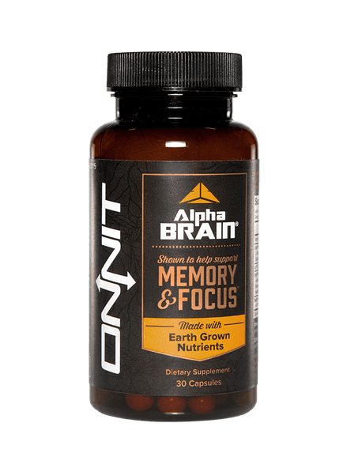
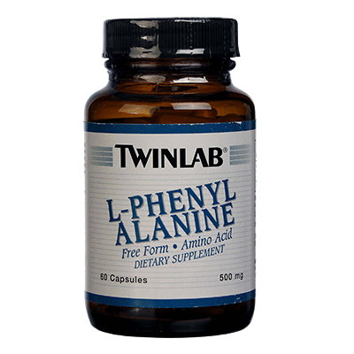
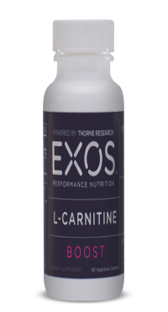

NOOTROPICS
L-PHENYL
ALANINE
CREATINE
CARNITINE
ALPHA-LIPOIC ACID
amino acid
increasing alertness and focus
HPA axis
slows down neuronal cell death
vegans and vegetarians
absorbable CreO2
variety roles in the brain
side-effects of aging
neurological decline with age
diabetic neuropathy
Notes:
9) L-Phenylalanine
L-Phenylalanine is an amino acid that is converted into L-tyrosine. L-tyrosine in turn is converted into L-Dopa, which is further converted into dopamine, norepinephrine (noradrenaline), and epinephrine (adrenaline) – the primary chemicals in your body responsible for increasing alertness and focus (15). The nice thing is that L-Phenylalanine can achieve this effect without throwing your HPA axis off kilter.
In other chapters of this book, you’ve learned about the performance-boosting effect of essential amino acids supplements (EAA’s). Most EAA’s include good doses of L-Phenylalanine in a balanced ratio to other amino acids. So their brain-boosting effect is yet another good reason to have them around.
——————————————–
10) Creatine
As I reported in my article “What Are The Best Biohacks Of The World’s Top Biohackers?”, I recently discovered that creatine not only has strength and power-enhancing effects, but can also be a very effective nootropic. Creatine can have a neuroprotective effect by slowing down neuronal cell death, and can also increase levels of the neurotransmitter glutamate, improve memory and learning, assist with depression, and suppress steep spikes in serotonin (1).
This is especially important news for vegans and vegetarians, who may find that by consuming adequate dietary fats combined with creatine, they can stave off much of the cognitive fuzziness that can accompany a plant-based diet.
Most studies on creatine use a “loading protocol” of 0.3g/kg bodyweight for 5-7 days followed by 5g of creatine per day after that. However, if you’re already eating meat, as little as 2g daily is enough supplementation to maintain average stores of creatine. I recommend the highly absorbable CreO2 from Millennium Sports.
——————————————–
11) Carnitine
Carnitine is another precursor to acetylcholine, and plays a variety of roles within your brain, including synthesis and stabilization of cell membranes, regulation of neural genes and proteins, better function of the “mitochondria” (the energy powerhouse of the cell), protection from free radical damage to the brain, better transmission of acetylcholine, and enhanced glucose uptake to the brain (13).
Carnitine has been shown to be very effective in alleviating the side-effects of aging, such as neurological decline and chronic fatigue, and also improving insulin sensitivity and blood vessel health. It has beneficial effects on neurons, repairing them from damage induced by some states such as high blood sugar. As you learned in Chapter 4, carnitine also increases fat burning and mitochondrial respiration. So you get a brain buzz, along with more energy when you use the stuff prior to workouts.
Brands vary, but I recommend 750mg-2,000mg/day, split into two daily doses. Both this and creatine would be good supplements to use if you’re doing lots of strength training or explosive exercise, and want to kill two birds with one stone.
——————————————–
12) Alpha-Lipoic Acid
Alpha-Lipoic Acid (ALA) is a fatty acid that can protect neurological decline with age, and can also be used as a treatment for diabetic neuropathy. Alpha lipoic acid can easily cross the blood-brain barrier (a wall of tiny vessels and structural cells that protect your brain), and pass into the brain to have these neuroprotective effects (10).
ALA has been shown to reduce oxidative damage in neuronal cells, increase the release of the neurotransmitter glutamate in your synapses, and increase dopamine and acetycholine availability. Brands vary, but the general dosage for a brain-boosting effect is 300-600mg of ALA.
——————————————–

Slide 34

NOOTROPICS
HUPERZINE
acetylcholinesterase inhibitor
herbal sources
TianChi Club Moss
Notes:
13) Huperzine
I think “Huperzine” supplements have been flying off the shelves since Tim Ferriss mentioned them in his popular “Four Hour Body” book. Huperzine is an “acetylcholinesterase inhibitor”, which means you get more of the neurotransmitter acetylcholine rushing around in your brain. You call these type of compounds “cholinomimetics“.
Acetylcholine is a very important neurotransmitter that is found in many nootropics, and the foundation of several smart drugs is to simply halt breakdown of acetylcholine, or maximize production of acetylcholine (also known as aceytlcholine agonists).
Studies have shown that Huperzine supplementation has neuroprotective effects and enhances cognitive function in animals and humans (16) – but what most people don’t know is that there are natural herbal sources of Huperzine. For example, in Chinese herbal medicine, an herb called “Club Moss” is used slow progression of Alzheimer’s. Guess what the active ingredient in Club Moss is? That’s right – Huperzine.
Be very careful if you’re going to order Club Moss. Most Chinese herbs sit in big bins in China for several years and get old, ineffective, and sprayed with toxic ethylene oxide. TianChi is the only Chinese adaptogenic herb complex that I’ve found which actually has effective doses Club Moss, along with a cocktail of other brain-boosting ingredients – including citicholine, which is one of the best ways to acetylcholine. It’s spendy but in my opinion well worth it. I take one packet of TianChi on an empty stomach every morning, and if you were going to do one thing in this entire post that you could feel instantly in your brain, this would be it.

Slide 35


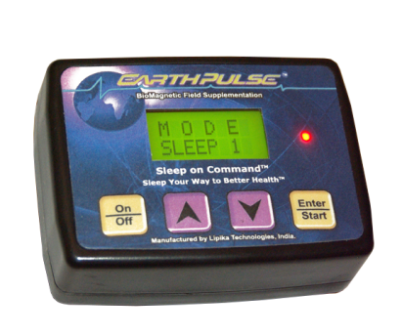

BRAIN ENHANCING GEAR
LIGHT
THERAPY
SOUND FREQUENCIES
ELECTRICAL STIMULATION
NEURO-
FEEDBACK
daytime melatonin
blue light retina damage
melatonin cycle
Human Charger, Re-Timer, Lighting Science Bulbs
neurotransmitter production
SleepStream
audio–visual entrainment
transcranial Direct Current Stimulation (tDCS)
Cranial Electrotherapy Stimulation (CES)
Pulsed Electromagnetic Frequencies (PEMF)
Upgraded Focus Brain Trainer
Journey to the Wild Divine game
visit a licensed biofeedback practitioner
Notes:
Brain Enhancing Gear
14) Light Therapy
A dip in alertness and focus during the day can often be due to excessive melatonin, which can induce sleepiness. Unfortunately, most websites, magazines or books tell you that the answer to this issue is to expose the eyes to more light in the morning via using something like a “light box”, which produces blue light.
The problem with this is that although it suppresses melatonin production and can increase alertness, this type of blue light is a wavelength of light that can cause damage to your retina, and eventually macular degeneration and loss of good vision.
It appears that the best way to increase mental acuity and focus during the day is to advance the melatonin cycle so that it finishes before you even wake up. Basically, you do this by 1) limiting your exposure to blue light in the early evening – via both limiting use of TV’s, e-readers, phones, and computers at night, and also using blue-light blocking glasses, applications like Flux, and computer screen covers in the evening; 2) getting as much morning sun exposure as possible, and if that’s not an option, waking with a Sunrise clock or waking light in your bedroom.
——————————————–
15) Sound Frequencies
As you learned in Chapter 3, your brain waves respond quite readily to sound frequencies, beats, notes and music. There’s a direct correlation between amplification of these brainwaves and neurotransmitter production. I’d highly recommend you go back and read that section of the book, in which I recommend Dr. Jeffrey Thompson’s neuroacoustics CD’s, the Entrainer Acoustics downloadable .mp3 audio tracks, and the wristband that emits specific frequencies to amplify alpha brain wave production.
In that chapter, I also mention audio–visual entrainment, which takes the concept of sound one step further, combines it with visual stimulation, and uses flashes of lights and pulses of tones to guide the brain into various states of brainwave activity. There’s an interesting device called the DAVID Delight Pro made by MindAlive that does this. I do not personally use this device, but many biohackers swear by it.
——————————————–
16) Electrical Stimulation
In Chapter 21, you saw how cyclists could be “tricked” into performing at a higher capacity when they were electrically stimulated prior to a ride to exhaustion. Pulsed electrical currents across head not only distract the cortex in a manner that can increase physical performance, but can also increase blood flow to the brain, and increase production of neurotransmitters and alpha brain waves.
Devices available for electrical stimulation of the brain include:
-Transcranial Direct Current Stimulation (tDCS), which passes a current across your forehead, and is being tested by the U.S. Air Force as a cognitive enhancement device. At Foc.us, you can grab a smartphone-controlled tDCS device that looks like high-tech pair of sunglasses for $249. Another popular device is the FisherWallace stimulator, which is a headband based cranial stimulation device.
-Cranial Electrotherapy Stimulation (CES), which is similar to tDCS but applies a current to your earlobes rather than your forehead. MindAlive also makes a CES device called an Oasis, as well as a device called the DAVID PAL 36, which combines light and sound with electrical stimulation.
-Pulsed Electromagnetic Frequencies (PEMF). A magnetic frequency in the 10Hz range (completely safe and far lower than what a cell phone would radiate), increases cell membrane potential in your brain and amplifies alpha brain wave production. This can be useful for both focus, and sleep. I personally use the Earthpulse PEMF device under my mattress while sleeping, but also place it on my desk while working.
The field of both electrical devices and neuro feedback is growing my leaps and bounds at the time of this writing, and by the time you read this, I’m sure new devices will have already hit the market. To stay on the cutting-edge of brain-hacking gear, I’d recommend following the website QuantifiedSelf.com.
——————————————–
17) NeuroFeedback
Neurofeedback (AKA biofeedback) devices – which were first introduced in Chapter 8 – actually do nothing to your brain. They simply show you what your brain is doing so you can train your brain to focus, block pain, learn faster, etc..
For example, at UpgradedSelf.com, you can get the “Upgraded Focus Brain Trainer”, which includes a headband with small red and infrared LED lights that shine through the skin and skull to assess the color of your. brain tissue. This light is then reflected back to a camera that measures the exact color of oxygenated brain blood. The headband then sends your brain’s data to your computer so you can correct what you’re doing in real time (e.g. think relaxing thoughts, focus better, make a faster decision, etc.) – and increase blood circulation to your brain.
In this case, the neurofeedback device is based on studies that show a direct relationship between an increase in brain performance and oxygenation of blood supply. More blood flow also results in faster removal of waste metabolites from brain tissues, and more capillaries and neuron connections within the trained area of the brain.
Another example of neurofeedback is the game “Journey to the Wild Divine“, which measures skin resistance and heart rate to detect your level of stress then train you to achieve a higher level of awareness and decreased stress.
In the recovery section of this book, you also learned about coherence training, in which you can train yourself to increase heart rate variability by using special software made by the Heart Math Institute, connected to an earlobe device called the emWave2 ($169) or the smartphone Inner Balance sensor ($99). Based on the intimate connection between your heart and your brain, as your heart rate variability increases, you can increase both alpha brain wave production and neurotransmitter production. Amazingly, the heart’s electrical field is up to 60x greater than the brain’s field, and can not only interact with your own brain, but with the brain of others around you. So you may find that as you teach yourself how to improve your heart rate variability, you may also enhance mental focus and relaxation of co-workers, friends and family.
Finally, you can visit a licensed biofeedback practitioner, which you can find at BCIA.org. When you visit a biofeedback practitioner, you can expect to take a comprehensive questionnaire, followed by an electroencephalogram of your brain. This results in a brain map (QEEG), which shows overactivity under activity in certain areas of your brain. You then engage in feedback sessions that may involve a simple light or tone or game that will move and play when desired brain activity is detected by the system. For other brain activity the rewarding tone, or light or game is taken away. Typically, it takes 20 to 40 biofeedback visits for to overcome issues such as cravings, anxiety, depression, etc. – so this is a technique more commonly used for actual brain problems rather than for actual brain enhancement.

Slide 36




BRAIN ENHANCING ACTIVITIES
BRAIN AEROBICS
CHEWING GUM
AEROBIC EXERCISE
MUSIC
Sudoko
novelty, variety, and challenge
Dr. Arlene Taylor
Brainscape and n-Back on the iTunes store
relieve stress
may increase blood flow to the brain
choose free of artificial sweeteners and chemical colors
Brain Derived Neurotrophic Factor (BDNF)
20-45 minute run, bike ride or other cardio
do enough to get your heart beating and your blood flowing
dopaminergic neurotransmission
increases blood, via 'calmodulin pathway'
most powerful effects through learning of music
Notes:
Brain Enhancing Activities
18) Brain Aerobics
There is continuing research that doing brain aerobic exercises (like Sudoko) can help to “age-proof” your brain and slow the onset of symptoms of brain aging, and can also help to keep your brain functioning at peak capacity. To qualify as a good brain aerobics exercise, an activity must have novelty, variety, and challenge (8).
In other words, going to work every day to your “mentally challenging” job does not provide the novelty to challenge your brain, sticking with the same “brain aerobics” activity day-after-day does not provide the variety, and engaging in brain activities that are familiar to you or easy (such as playing the same challenging computer game every day) eventually does not provide the challenge.
In other words: make your brain lift heavy stuff. One of my friends, Dr. Arlene Taylor, has a bunch of completely free brain aerobic exercises on her website.
You can also go do a search in the Apple iTunes store, or any other app store, for “brain exercises” and find good apps that will challenge your brain (Angry Birds probably doesn’t count). Two of my favorites are the Brainscape app, which allows you to create your own flash cards and learning activities which you can easily access from your phone, and n-Back training, which involves memorizing a progressively more difficult sequence of colored squares.
Incidentally, if you play a sport in a way that causes you to think ahead and solve problems as you go, activities such tennis or golf also count – as do board games like chess and checkers.
——————————————–
19) Chewing Gum
Many people chew gum to relieve stress, and some believe that it helps them to concentrate (14). Some neuroscience researchers have studied whether chewing gum might improve attention, memory, and other aspects of cognition. Although the research is not entirely conclusive, the idea is that the act of chewing gum may increase blood flow to the brain, delivering not only nutrients but also additional oxygen.
Despite the back-and-forth nature of research, chewing gum is a frequent habit of mine when writing and engaging in mentally demanding or stressful tasks. Just make sure you chew a good brand that is free of artificial sweeteners, chemical colors and sweeteners (I recommend B-Fresh).
——————————————–
20) Aerobic Exercise
Theer is a compound called Brain Derived Neurotrophic Factor, or BDNF, which is a protein that acts on neurons in your central nervous system (CNS) and peripheral nervous system (PNS) to help your existing neurons survive and thrive and also to encourage the growth of new neurons and neuronal connections (also known as “synapses”).
Research has shown that exercise, and specifically aerobic exercise, can significantly enhance secretion of BDNF (6). Why should exercise need to be aerobic to affect the brain? It appears that various growth factors must be carried from the periphery of your body into your brain to start a molecular cascade there for BDNF creation – and to make this happen you need a fairly dramatic change in blood flow. You could get this same blood flow with weight training, but unfortunately, weight training stimulates the production of growth factors in the muscles that stay in the muscles and aren’t transported to the brain.
So how can you implement exercise to make you smarter?
I recommend fitting in an aerobic 20-45 minute run, bike ride, or other bout of cardio on the morning of any day in which you have high intellectual demands. It doesn’t have to be hard or make your legs, arms, or lungs burn. Just do enough to get your heart beating and your blood flowing (about a 4-6 on a 1-10 difficulty scale). In this case, harder is not better, and could actually leave you excessively fatigued. In addition, excess cortisol has actually been shown to reduce BDNF.
——————————————-
21) Music
In addition to helping you exercise harder, music has been proven in studies to assist with “dopaminergic neurotransmission”, which basically means that – similar to the use of binaural beats and sounds – it can cause a giant dopamine release in your brain, and make you smarter and more mentally responsive. Exposure to music also significantly increases blood, which, via something called a “calmodulin pathway”, may cause a reduction in blood pressure and increased blood flow to the brain (7).
However, music can also be distracting, so don’t constantly pump it into your ears. The most powerful effects of music on brain development have instead been demonstrated through actual learning of music. Yes, I am suggesting that you pick up a musical instrument, play Guitar Hero occasionally, or install that “mini-piano” app on your phone. Seriously.
Read more http://www.bengreenfieldfitness.com/2013/08/how-to-increase-your-brain-power/

Slide 37
3
A typical “brain-hacking” day in my life
A degree of simplicity is also important
'The Edge Effect' and 'Younger Brain, Sharper Mind' by Dr. Eric Braverman
’How To Make Your Own Smart Drugs’ at BenGreenfieldFitness.com
HOW TO INCREASE YOUR BRAIN POWER
SUMMARY
Notes:
Summary
Finally, as promised, I’m going to give you a typical “brain-hacking” day in my life so that you know what I personally do when it comes to using these 21 ways that I’ve just provided you with.
6:30am: Wake up. 5 minutes of Heart Rate Variability training while lying in bed.
6:45am: 1 cup of coffee (occasionally substitute delta-E or green tea)
7am: 10-15 minutes of light aerobic exercise (yoga and calisthenics) in the morning sunshine.
8am: 1 glass of TianChi with 8-10g fish oil. Three months of the year, also include creatine (during off-season weight training period).
9am: High fat breakfast, including MCT oil.
10am: Work, while chewing gum and keeping Earthpulse on if more focus needed.
12pm: High fat lunch, usually includes sardines, eggs, herring or mackerel.
4pm: Workout, include learning at least one new exercise or movement.
7pm: High fat dinner.
8pm: Guitar or tennis practice.
9pm: Reading book or Kindle with low blue light glasses.
10pm: Bedtime in darkness. Sleep on Earthpulse.
Hopefully that gives you a good idea of how these strategies can be implemented seamlessly into a typical day, without you feeling like you’re constantly going out of your way to “hack your brain”. You may have noticed that the only piece of “gear” I use is the Earthpulse. That’s not because I don’t believe in the efficacy of electrical devices and other forms of neurobeedback, but just because some degree of simplicity is also important, so I’ve identified the weapons of choice that work for me and tried to avoid having too many brain-hacking toys lying around the house.
If you want more resources, the best two brain-enhancing books I’ve read to date are written by Dr. Eric Braverman – a true brain expert. They are “The Edge Effect“, which discusses how to treat your brain to reverse or prevent Alzheimer’s aging, memory loss, weight gain, and sexual dysfunction, and “Younger Brain, Sharper Mind“, which is a 6-step plan for preserving and improving memory and attention at any age. As mentioned earlier, I’d also highly recommend you grab the free e-book “The Limitless Pill“, by Mark Joyner.
Finally, if you have questions, comments or feedback about nootropics, brain-hacking gear or brain-enhancing activities, leave them below and I promise to reply!
Read more http://www.bengreenfieldfitness.com/2013/08/how-to-increase-your-brain-power/

Slide 38

Q & A
Want all resources, links & goodies
for this presentation? Visit bengreenfieldfitness.com/unbeatable15

