Slide 1
Quantum Upgrade July 20th, 2023

Slide 2
ATP Production
US university lab did a randomized, double-blind study with human cells. It showed and proved with statistical significance an increase of ATP production of up to 20-29% by human cells.

Slide 3
Wound-healing
85-100% acceleration of wound-healing of human cells shown in University lab by Associate Professor Dr. Robert Sheaf
This has very positive implications in regard to athletic performance, recovery, and any healing processes

Slide 4
Live-Blood Analysis
Quantum Upgrade shown to improve human blood and blood flow in a significant way in placebo-controlled, double-blind studies:
- Reversal of stage 1 & 2 of blood clotting within minutes
Increase of white blood cell activity and motility
Reduction in parasitic load
More oxygenated
Baseline Blood
Wi-Fi Exposure Blood
Quantum Bloc Exposure Blood

Slide 5
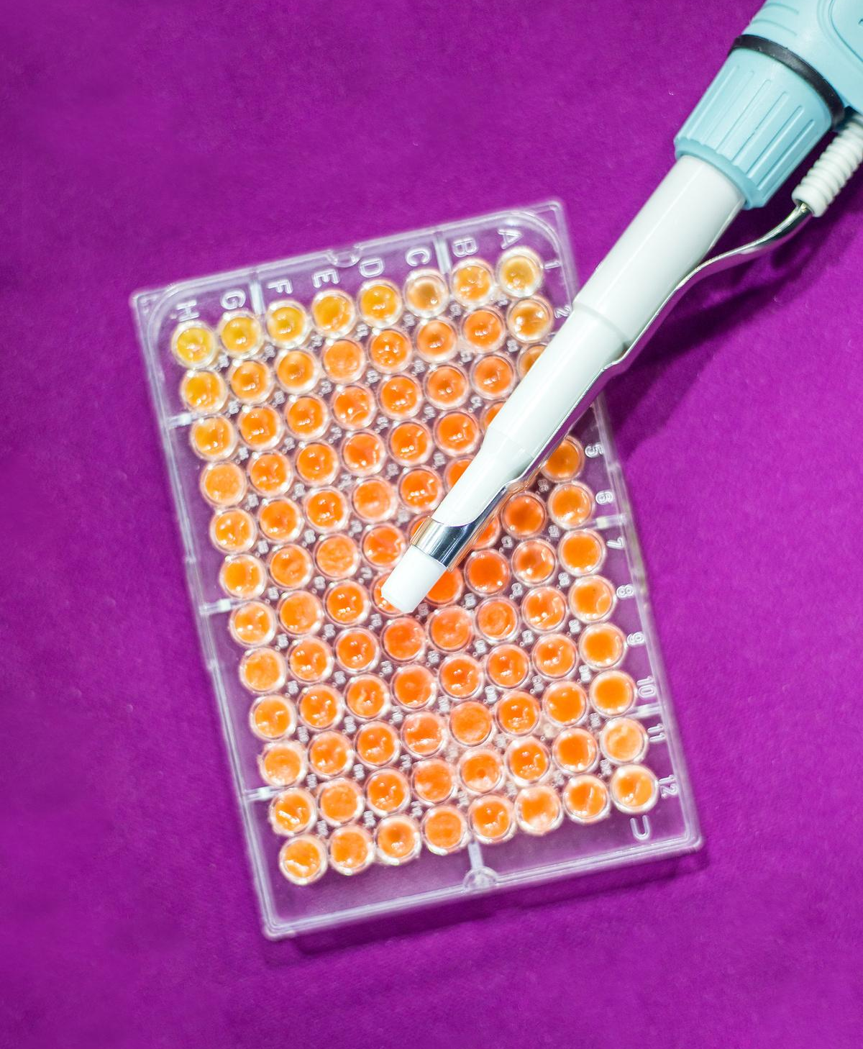
Clinical Study with
Autistic Children, India
Midterm results:
70% of kids showed significant improvement
30% showed at least “improvement” in all areas (incl speech, attention span, and bowel movement)
Reduced ATEC scores by 20 basis points
Will be published soon (currently being peer-reviewed)

Slide 6
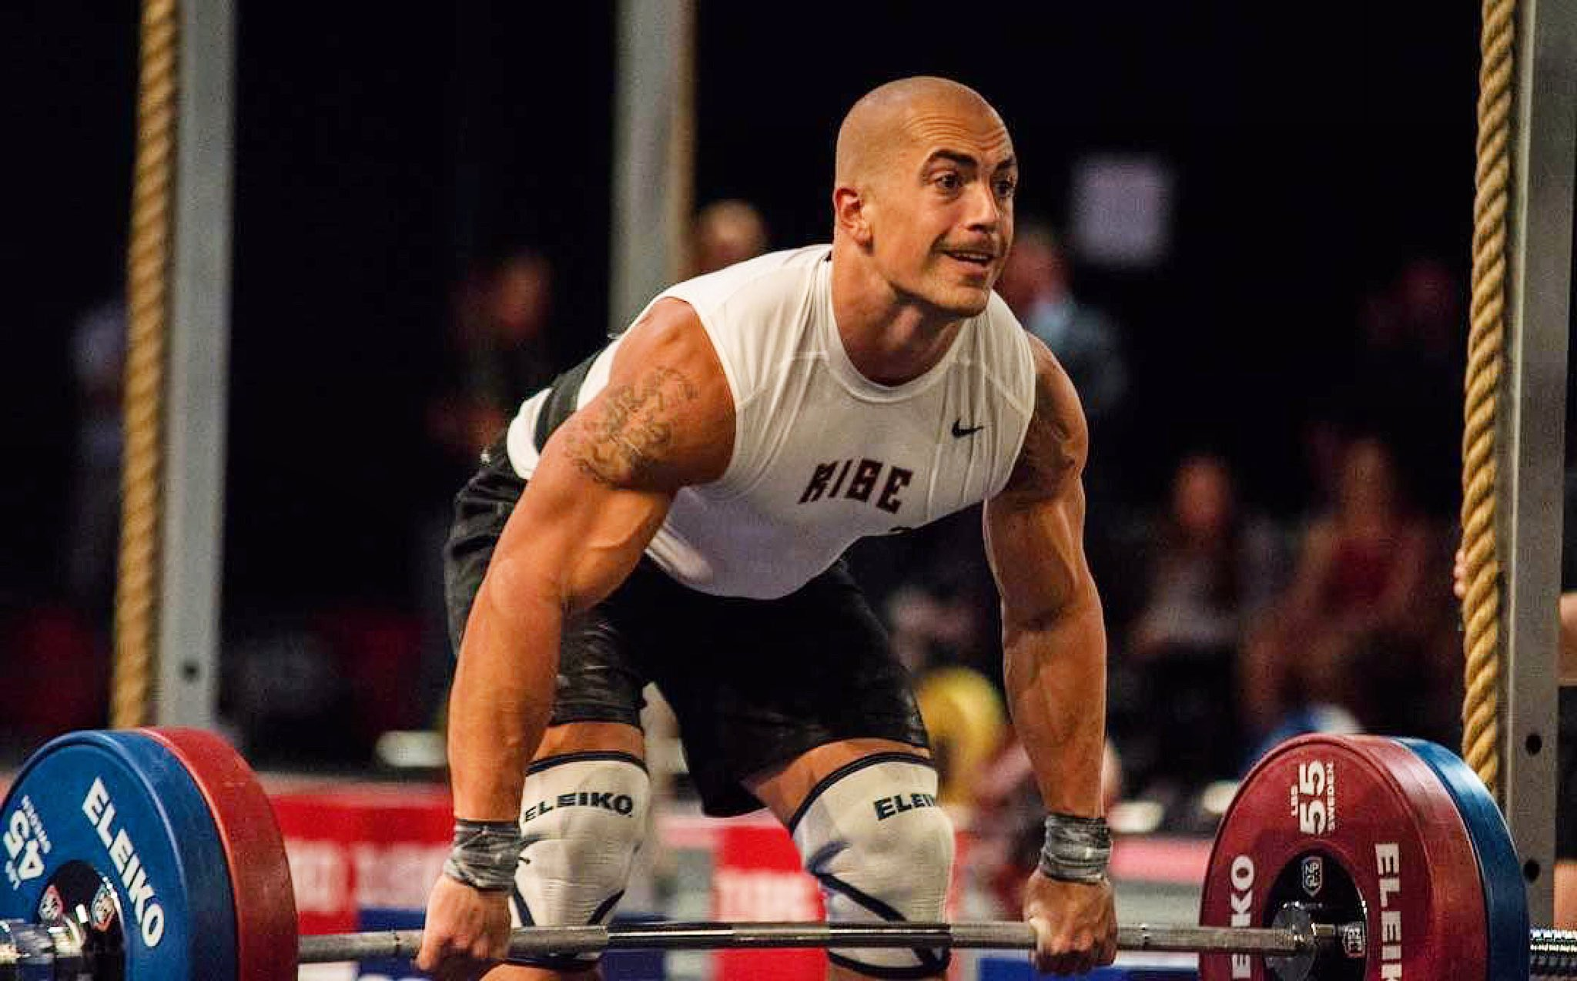
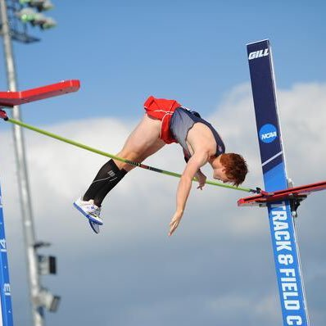
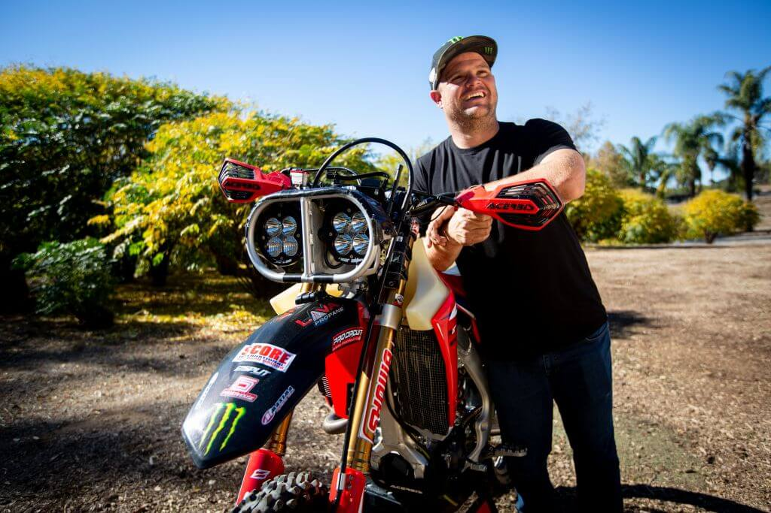
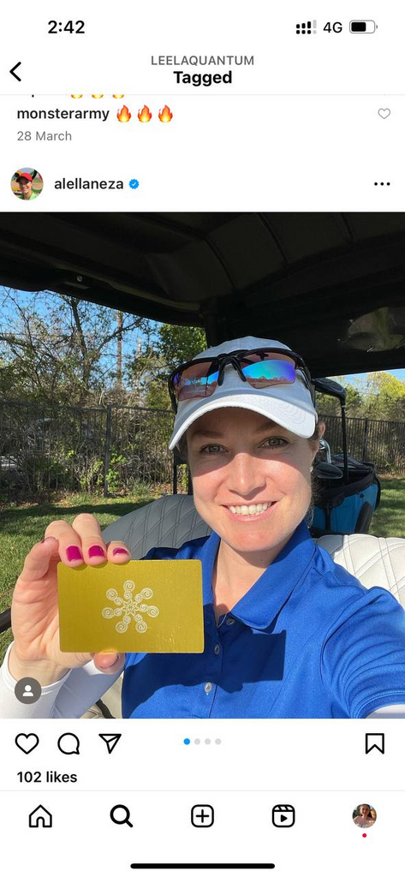
Blaine McConnell
Trusted by...
Blaine McConnell (World Cup Champion Bobsled)
Mark Samuels (7-times Baja 1000 Winner)
SLR Honda Motocross Team
Maggie Voisin (7x Xgames medalist and 3x Olympian)
Carson Waters (5.71 meters US pole vaulter)
Major league Baseball Players, professional Tennis Players, and a top US Pro Golfers
Thousands of the Customers
Carson Waters
Mark Samuels
Maggie Voisin
Alejandra Llaneza
Maggie Voisin

